Slide 1
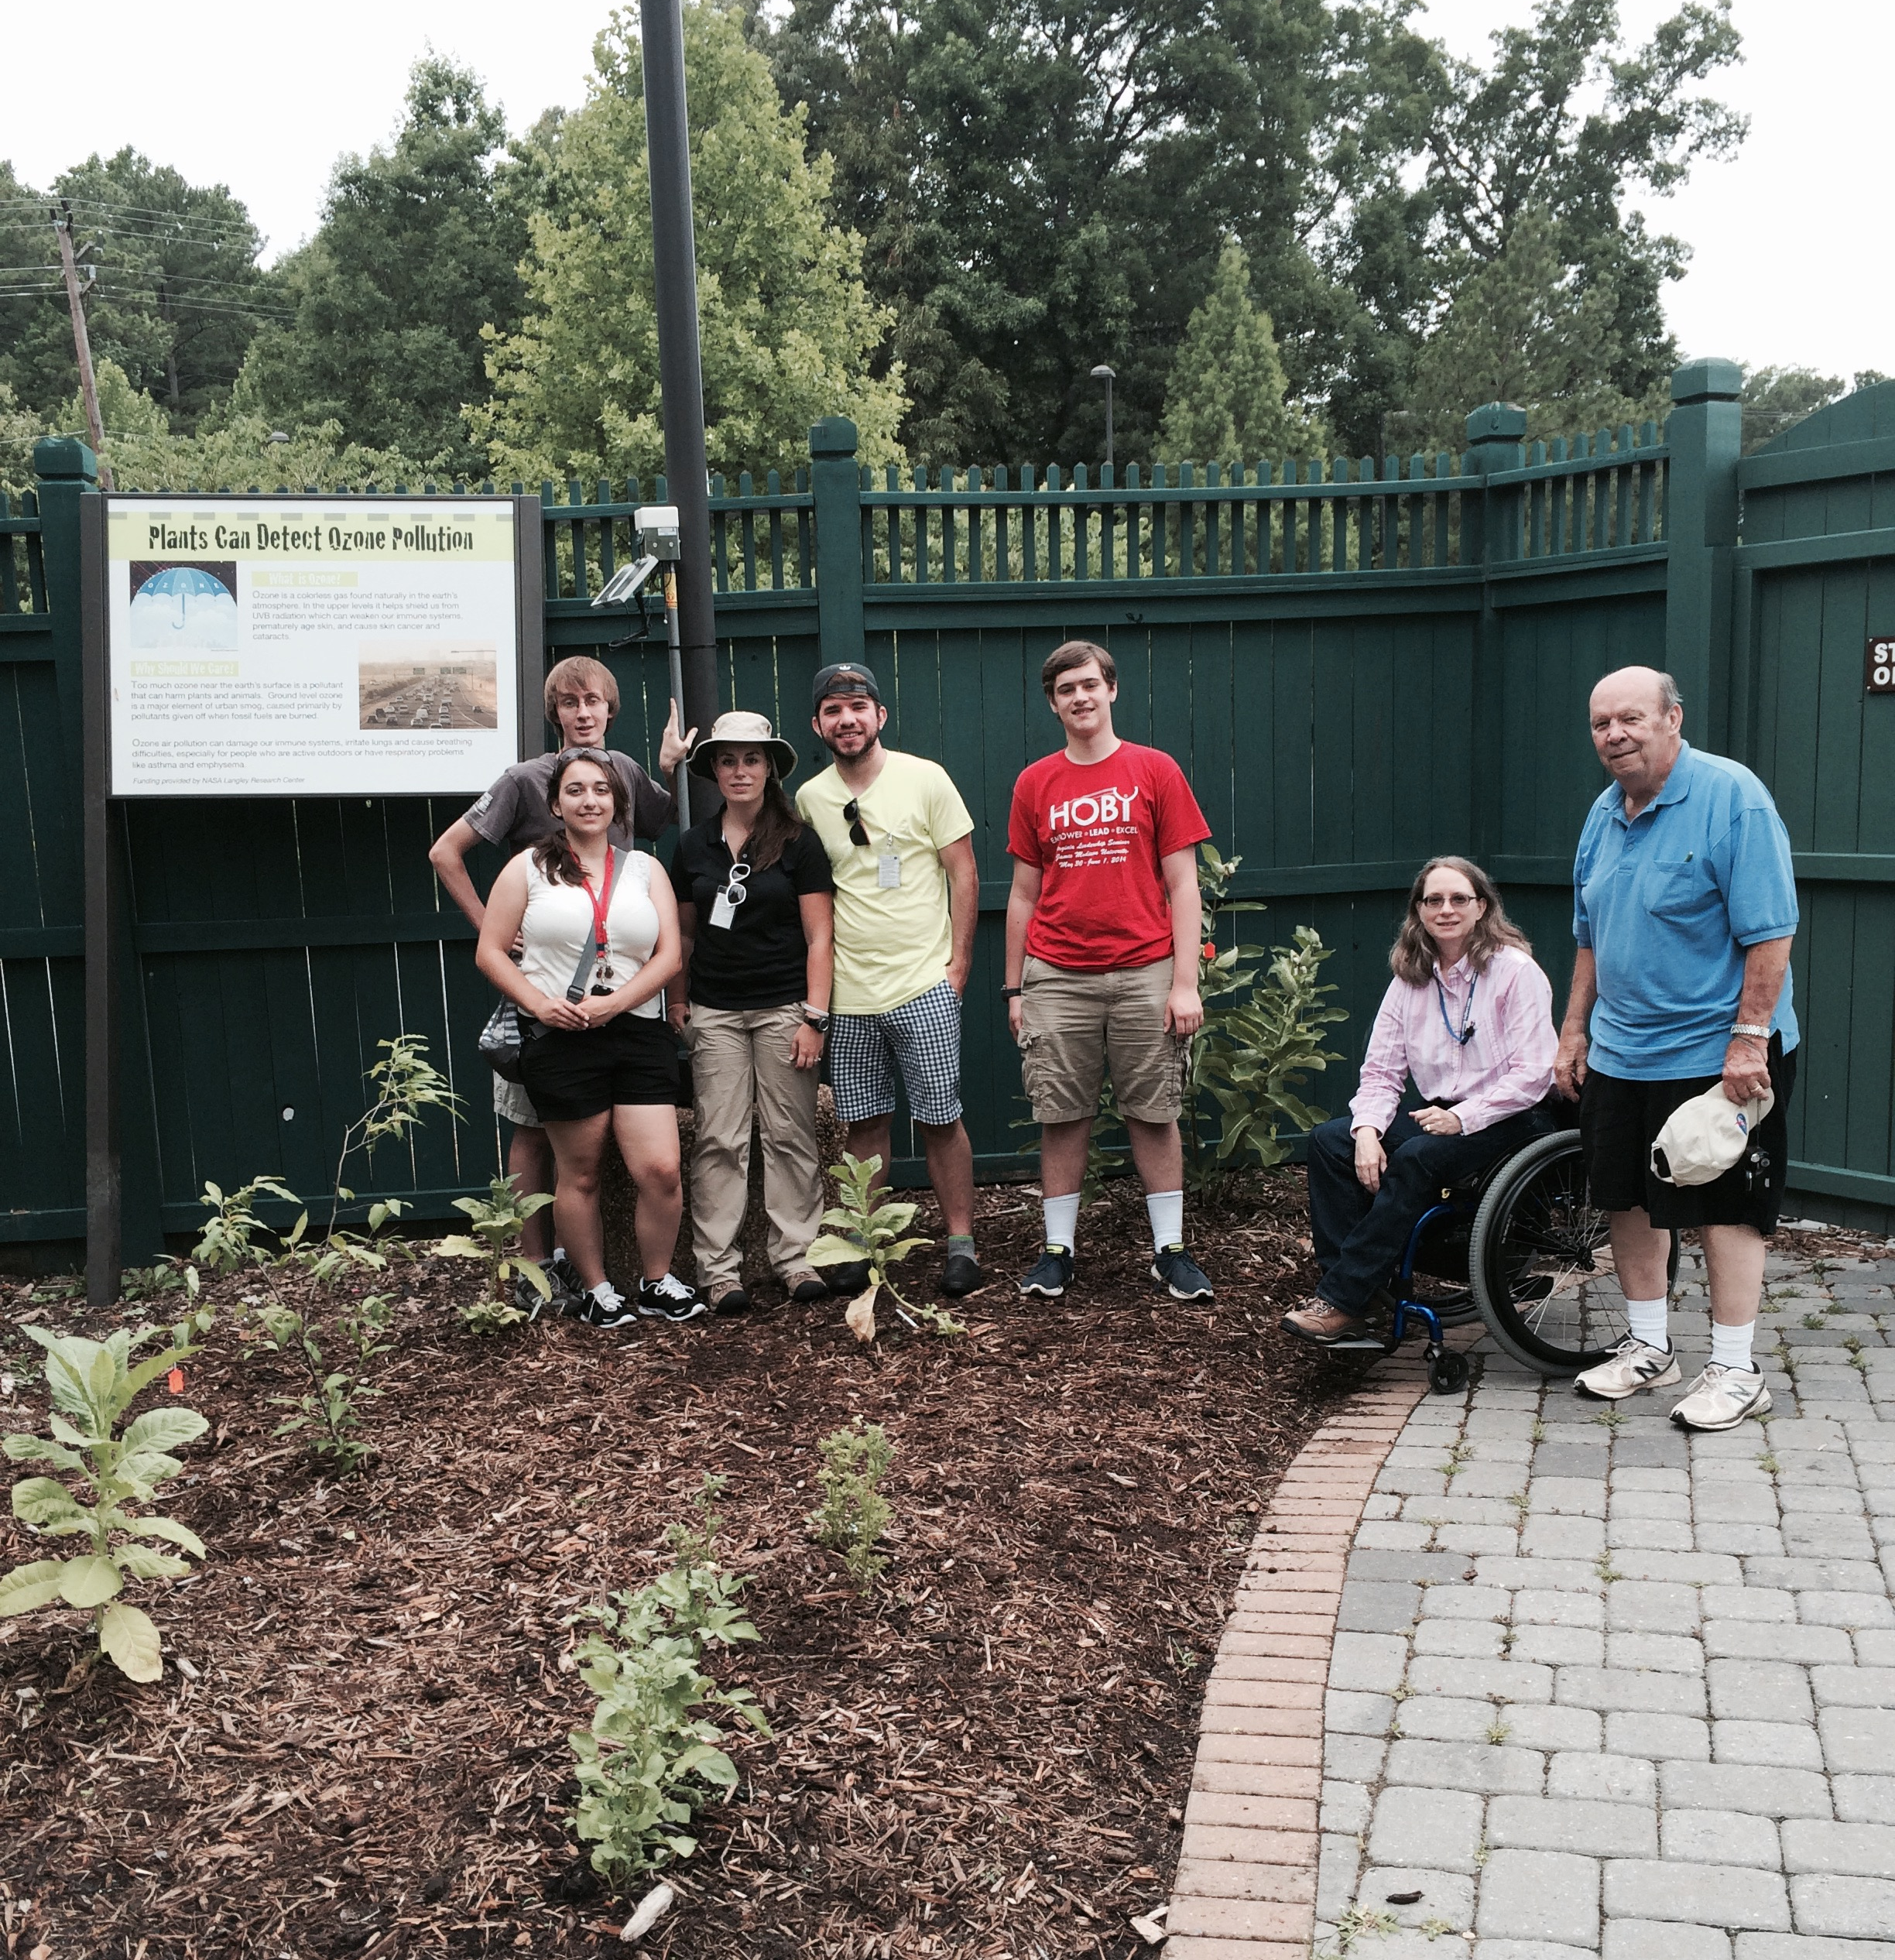
TEMPO SC & C/PE 2015-2016
    Summer 2015: 5 NASA interns
    - Re-evaluated small sensors (Calitoo) for AOD after
    re-calibration and software updates by vendor
    (2014 evaluation resulted in instrument recall by vendor)
    - Piloted the Ozone Garden at Virginia Living Museum
    Cairclip O3+NO2 sensors at CAPABLE and VLM compared to VA DEQ O3 and NO2. Leaf stippling photographs correlated with ozone throughout summer. Lessons learned documented.
Calitoo captures a Canadian wildfire
smoke plume over Hampton, VA
    Fall 2015: 1 NASA intern
    - Evaluation and troubleshooting of 35 Calitoos
    - Calitoos currently being used in GLOBE Aerosol Field Campaign
    Spring 2016: 1 NASA intern
    - Developed educational materials and activities (and museum volunteer training manual) for public engagement at the VLM Ozone Garden to be implemented summer 2016
    - Intern is now employed by VLM as an Education Associate

Slide 2
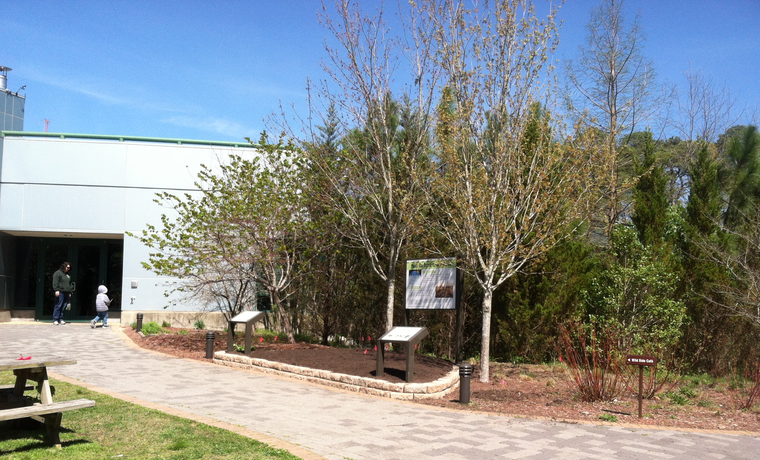
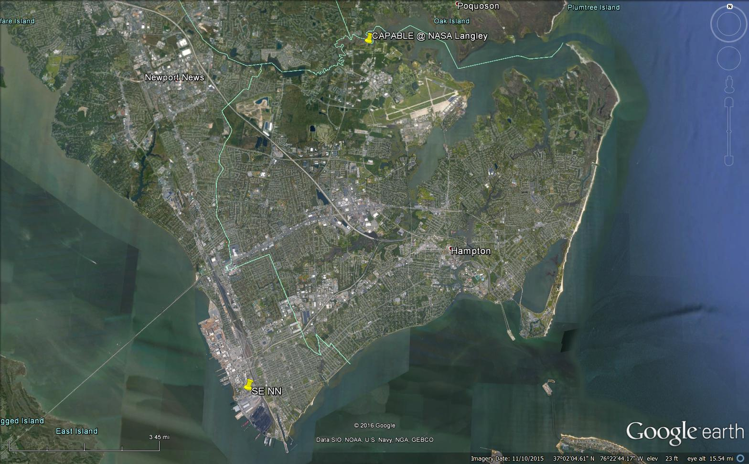
TEMPO SC & C/PE Summer 2016
Summer 2016: 2 returning student interns + 3 educators
Focus - Full implementation of Ozone Garden activities
- student research using Cairclip O3+NO2 & 2BTech POMs, leaf stippling observations with time-lapsed camera and still photography to correlate with ozone;
- public engagement for citizen scientists of all ages,
using data collection sheets and educational activities
developed in Spring 2016
VLM Ozone Garden
relocated to high traffic area
Pilot spatial distribution study
- Compare O3 and aerosol within TEMPO pixel
and between two pixels
- Continue evaluation of Cairclip O3+NO2 & NO2,
Aeroqual O3 & NO2, and aerosol AOD compared
with VA DEQ and AERONET at CAPABLE site
- Begin H2O measurements with GLOBE
small sensor and compare with Aeronet & Pandora

